Slide 1
Curriculum Leaders Meeting
January 2024

Slide 2

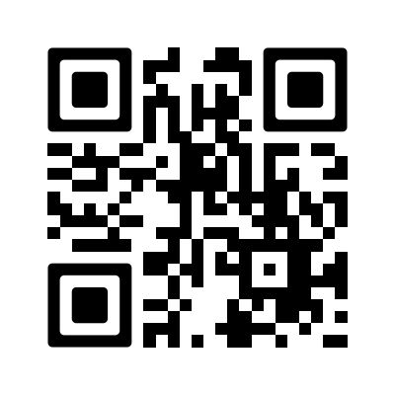

CHECK - IN
Networking Session
Topics for Discussion Today
New Graduation Requirements
  What steps are you taking to implement the changes?
  What challenges are you facing and how are you overcoming those challenges?
ELA standards
  What work has your district completed to align to the new standards?
  What programs are you utilizing to support the standards?
Evidence based programs supported by At-Risk funding
  If you are leaving a program, what are you thinking about replacing it with in the future?
  What evidencebased programs are showing evidence of improved student achievement?
Spreadsheet- Who is here!

Slide 3
Dr. Randy Watson
Kansas Commissioner of Education

Slide 4
Update on New State Assessments
Beginning in 2024-2025
Curriculum Leader’s Meeting
January 19, 2024

Slide 5
Overview
The Achievement and Assessment Institute (AAI) in partnership with the Kansas State Department of Education (KSDE) determined the content to be assessed by Kansas Assessment Program (KAP) tests for each subject area and specific grade.
The 2025 English language arts (ELA) summative assessment is aligned to the 2023 Kansas Standards and 2017 Kansas Standards for Mathematics.
The 2025 science summative assessment is aligned to the 2013 Kansas Science Standards.
The 2025 KAP assessments have new blueprints.
All items on 2025 KAP assessments were newly developed and aligned to Kansas Standards.

Slide 6
Development Timeline
Milestone | Date | Note
Blueprint development | 2020-2022
Passage and item development | 2021-2023
Field-testing items | Spring 2022, Spring 2023, Spring 2024 | Newly developed items were field-tested on previous summative assessments.
Test construction | 2024-2025
First operational Summative administration aligned to new blueprint | Spring 2025
Standard setting | Summer 2025

Slide 7
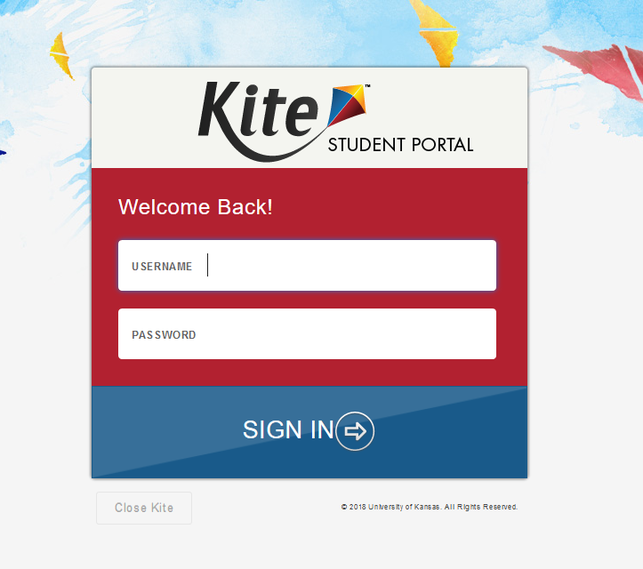
Kite Student Portal
Students will test online using the Kite Student Portal.

Slide 8
General Summative Assessments
Subject | Grades | Estimated Time to Complete (untimed)
Mathematics | 3 - 8, and10 | Two Sessions, 45-60 minutes each
English Language Arts | 3 - 8, and10 | Two Sessions, 45-60 minutes each
Science | 5, 8, and 11 | Two Sessions, 45 minutes each

Slide 9
Changes for Summative Assessment
Updated blueprints for summative assessment.
All new items for summative assessment.
Summative test has a max of 40 to 50 score points.
New cut scores will be determined in summer of 2025.

Slide 10
Changes for Summative Assessment
New Proposed Performance Level Descriptors.
Increased use of block-based items.
Removal of stand-alone writing items.
All writing items are embedded in passage-based blocks.

Slide 11
2 Sets of Performance Level Descriptors
Assessment Level Descriptors- overall description of performance on summative assessment.
Performance Level Descriptors (grade specific)- standards based descriptors. Available in the fall of 2024.
Goal for new assessments – use common terms to be less confusing.

Slide 12
Current Performance Level Descriptors
Level 1: A student at Level 1 shows a limited ability to understand and use the skills and knowledge needed for postsecondary readiness.
Level 2: A student at Level 2 shows a basic ability to understand and use the skills and knowledge needed for postsecondary readiness.
Level 3: A student at Level 3 shows an effective ability to understand and use the skills and knowledge needed for postsecondary readiness.
Level 4: A student at Level 4 shows an excellent ability to understand and use the skills and knowledge needed for postsecondary readiness.

Slide 13
Proposed Performance Level Descriptors
A student at Level 1 shows a limited ability to demonstrate their knowledge and skills of (third, fourth, fifth, etc.) grade (ELA, Math, Science) Kansas standards.
A student at Level 2 shows a basic ability to demonstrate their knowledge and skills of (third, fourth, fifth, etc.) grade (ELA, Math, Science) Kansas standards.
A student at Level 3 shows a proficient ability to demonstrate their knowledge and skills of (third, fourth, fifth, etc.) grade (ELA, Math, Science) Kansas standards.
A student at Level 4 shows an advanced ability to demonstrate their knowledge and skills of (third, fourth, fifth, etc.) grade (ELA, Math, Science) Kansas standards.

Slide 14
Interim Assessments
Updated blueprint.
All new items for interim assessment.
Interim assessments better aligned with instructional sequence.
Results designed to be used to improve instruction.

Slide 15
Interim Assessments
Moving from 3 Interims to 2.
ELA & Math grade 3 - 8 & 10.
Introduction of interims for science grade 5 and 8.
Introduction of middle school focused interims.

Slide 16
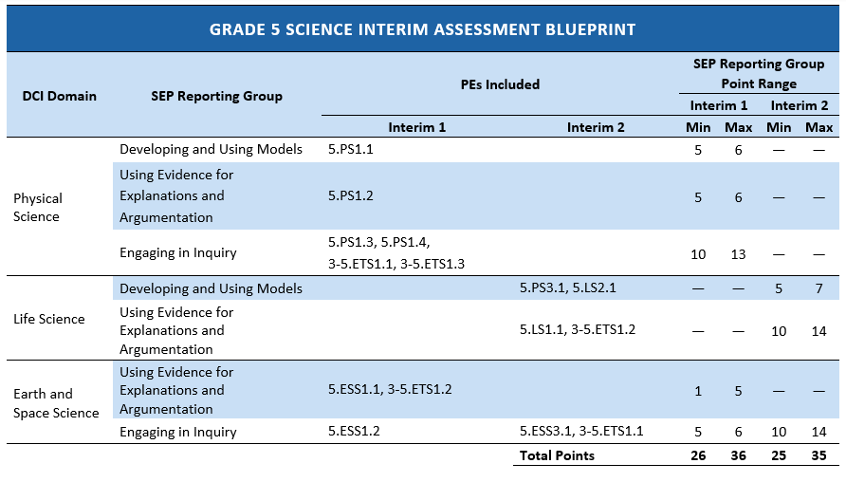
Example of Interim Assessment Blueprints

Slide 17
Assessment Development Guides
Assessment Development Guides (Blueprints) will be available on KAP website for ELA, math, and science
  Summative
  Interim

Slide 18
Kansas Assessment Advisory Council
The Kansas Assessment Advisory Council (KAAC) was created in the fall of 2003 as an advisory group for the Kansas Assessments and to the KSDE Assessment Coordinator.
Members came from a group of testing coordinators who had been meeting informally for several years. KSDE requested that bylaws be developed for the KAAC.
Bylaws were proposed and approved at the August 6, 2013, KAAC meeting.

Slide 19
Kansas Assessment Advisory Council
Review and provide input to KSDE staff on the Kansas Assessment system and the components of that system.
Advise KSDE of issues and needs from the district perspective.
As local assessment experts, willingly share and seek ideas and responses from districts on Kansas assessment initiatives.
Provide advice and recommendations regarding the preparation for and administration of the state assessments.
Provide recommendations concerning issues related to assessment timelines and procedures.
Assist in developing training materials and/or resources addressing assessment issues in Kansas including assisting in the annual test coordinator trainings in assessment ethics, best practices, test security, and new Test Coordinator orientation.
Assist KSDE staff in conducting Test Security Monitoring visits as required by the state testing vendor and/or US Department of Education.

Slide 20
Kansas Assessment Advisory Council
Membership
KAAC membership will consist of 33 district representatives, KSDE staff with assessment responsibilities, and a representative from Kansas State School for the Deaf or Kansas State School for the Blind.
District representatives should have a minimum of two full years of experience as a District Test Coordinator.
Except for the six largest school districts, each KAAC member serves a three-year term and may serve a maximum of two consecutive terms on KAAC.
Collectively, KAAC represents all school districts and area of the state. KSDE may add additional representatives to assure KAAC adequately responds to the testing needs of special population students (ELs and disabled students).

Slide 21
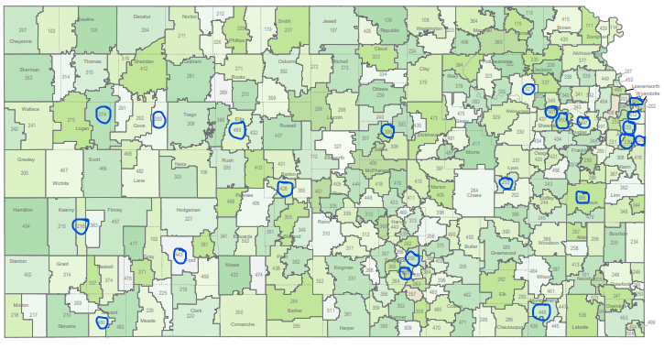
KAAC Member Representation

Slide 22
Technical Advisory Committee (TAC)
Federal requirement for large scale standardized assessment.
7 national assessment experts provide guidance on peer review, assessment development, reporting, reliability, etc.
Meet 3 times a year in-person
Appointed KAAC member attends
Members from AAI attend/present
Assessment staff from KSDE

Slide 23
  Julie Ewing
  Assistant Director
  Career, Standards and Assessment Services
  (785) 296-2325
  jewing@ksde.org

Slide 24
Standards Update
KSDE Program Managers

Slide 25
Literacy - LETRS

Slide 26

Definition of the Science of Reading
The science of reading is a vast, interdisciplinary body of scientifically-based research about reading and issues related to reading and writing. This research has been conducted over the last five decades across the world and is derived from thousands of studies conducted in multiple languages. The science of reading has culminated in a preponderance of evidence to inform how proficient reading and writing develop; why some have difficulty and how we can most effectively assess and teach and, therefore, improve student outcomes through prevention of and intervention for reading difficulties.
The Science of Reading Defining Guide
The Reading League 2021

Slide 27
Structured Literacy
Structured literacy refers to the explicit, systematic, diagnostic, and cumulative approach to teaching literacy that acknowledges the value of both word recognition and oral and written language comprehension as evidenced in all grades and disciplines.
Knowledge Matters!

Slide 28
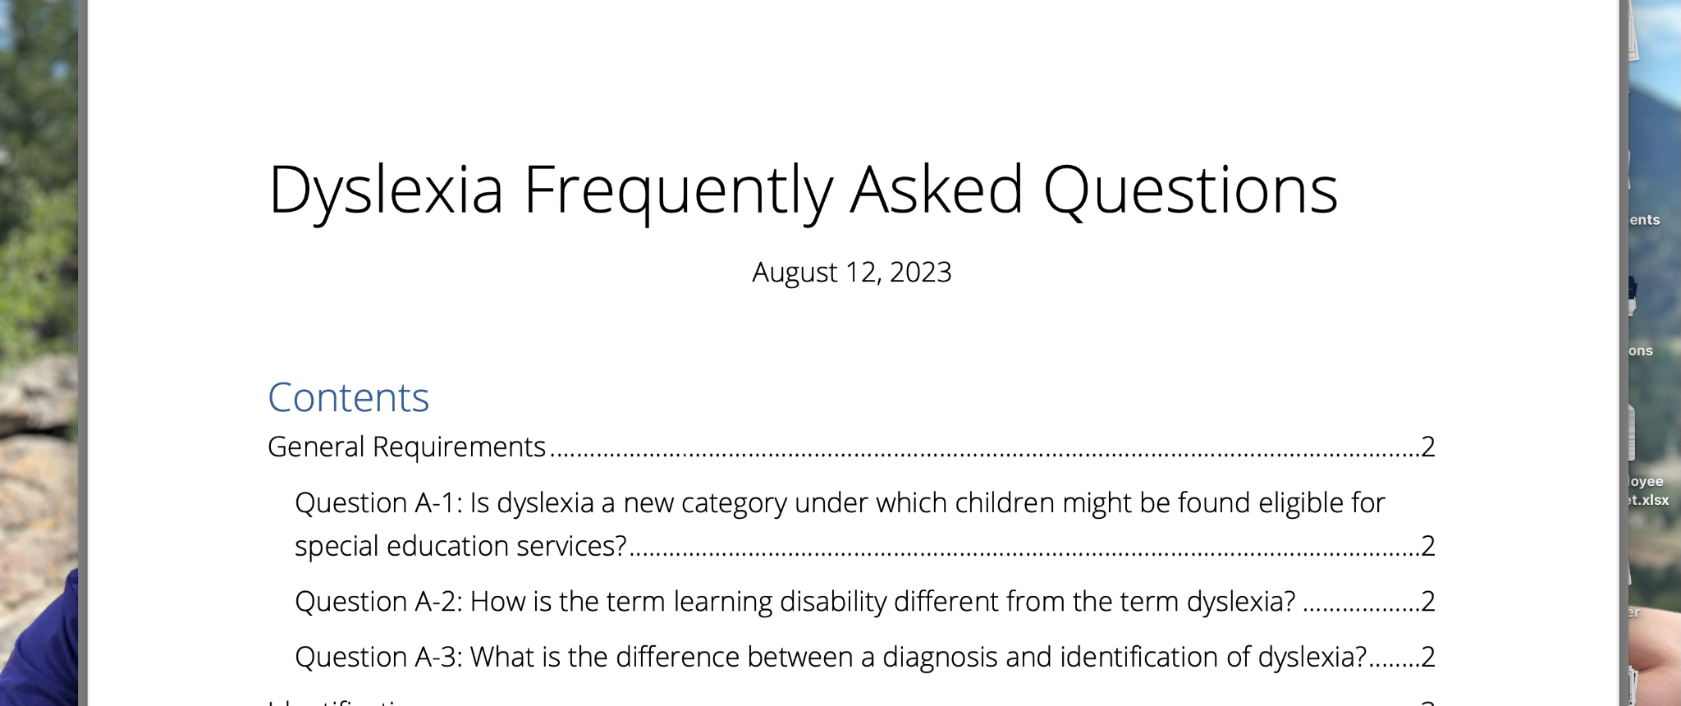
See the CSAS Dyslexia Page

Slide 29
Whether or not a child has a clinical diagnosis or has been identified through your school protocol- working with students that struggle in reading starts with a strong core of instruction.

Slide 30

Revised Dyslexia Handbook
2nd Grade Assessment (April)
Every Child Can Read Act

Slide 31
What we thought was happening…wasn’t happening.
fMRI studies
What’s the problem with balanced literacy?
What is the problem with using leveled books?
What is wrong with the 3 cueing system?
Eye Movement Studies
Evidence-Based Practices
Not just collecting data, but analyzing it

Slide 32

Do you have other questions?
We are here to help.
Literacy Lifeline is available
and we are happy to answer
any of your questions or assist you!

Slide 33

Final Registration will be summer, for fall 2024
LETRS Opportunities
One Year Curriculum: LETRS Early Childhood
Two more opportunities for teachers/ systems to join
Two Year Curriculum
Two more opportunities for teachers/ systems to join
Two Year Curriculum for Administrators
Two year opportunity for administrators
Kevin Davis and I meet weekly with
Lexia. If you have questions, please ask.
Registration open to individual teachers OR building/ district cohorts.
Contact TASN or Kevin Davis: kddavis@pittstate.edu
MORE INFO: LETRS

Slide 34
Laurie Curtis
Early Literacy/ Dyslexia Program Manager
CSAS
(785) 296-2749
lcurtis@ksde.org
Questions?

Slide 35
Career and Technical Education (CTE)
January 19, 2024

Slide 36
Pathway Application Reminders
Pathway Applications are due on March 1, 2024.
If an application is disapproved, there is a two-week time frame in which to make corrections.
Pathway-Specific Questions: KSDE Pathway Consultants
  KSDE Secondary-Level CTE Contacts
Pathways System Errors, General Questions: Pathways Helpdesk
  pathwayshelpdesk@ksde.org
Kansas Course Code Management System: KCCMS Helpdesk
  kccms@ksde.org
Notes:
Kansas Course Codes: February 15, 2024
New and Updated Course records must be mapped in KCCMS
All new and updated records require approval by KSDE staff
Double check that all course records in KCCMS match your SIS
Pathways Courses report in KCCMS and Pathways

Slide 37
Student Follow-Up Data
Collected February 1st through April 15th
Required data submission for Perkins
  Populates placement data
Follows up with students identified as Concentrators who Exited for 2022-2023 school year
Pathways Student Data Follow-Up Fact Sheet
Notes:
Options for follow up status:
Employed – Related to Program
Employed – Not Related to Program
Military
No Placement
Unknown
Advanced Training
Title I Service Program (ie. Peace Corps)
Continued Education – Associate Program
Continued Education – Baccalaureate Program
Continued Education – Certificate Program
Student Satisfaction
How satisfied is the student with the CTE program?
Very Satisfied
Satisfied
Unsatisfied

Slide 38
Upcoming Perkins Reserve Grant
Up to $30,000
Focus on special populations
Stipends, supplies, and equipment
Perkins Federal Accountability (ksde.org)
Perkins Reserve Grants posted.
Sent out on the Perkins Contacts ListServ.
Notes:
Focus on special populations
individuals with disabilities;
individuals from economically disadvantaged families, including low-income youth and adults;
individuals preparing for non-traditional fields;
single parents, including single pregnant women;
English learners;
homeless individuals described in section 725 of the McKinney-Vento Homeless Assistance Act
migrant worker parent
youth who are in, or have aged out of, the foster care system; and
youth with a parent who
is a member of the armed forces; and
is on active duty

Slide 39
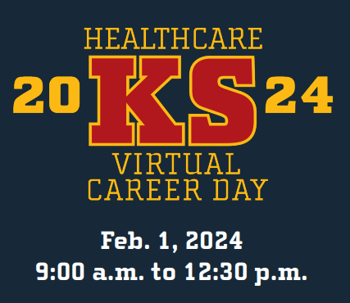

Happy In Health Care (kha-net.org)
Notes:
Registration is now open for the 2024 Virtual Health Care Career Day, which is scheduled for 9 a.m.-12:30 p.m. Feb. 1.
Several health careers will be highlighted, including physical therapy, radiology technologists, behavioral health, nursing, laboratory, EMT/paramedic, surgery and more.
Visit HappyInHealthCare.org to register and to discover schools, careers and scholarships dedicated to building a robust and thriving health care workforce.

Slide 40


Slide 41
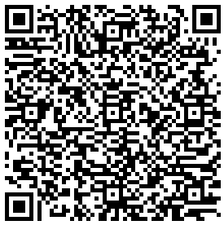

Kansas CTE Scholar Guide
The 2024 Application is now open. A guidance document that includes how to fill out the application, the link to the application, a checklist and Credits/GPA submission form is located at Kansas CTE Scholar Guide.docx (live.com).

Slide 42
2024 Kansas CTE Scholar
Due March 1
Senior-level status.
3.0 CTE credits in a selected Pathway and verification of
technical skill attainment.
3.5 GPA (minimum) in CTE classes.
Technical Skill Attainment
Civic Engagement or Outstanding Community Service
Career Vision Reflection
Online application with documentation is due by March 1, 2024.
Notes:
KS CTE Scholar
The KS CTE Scholar recognition was awarded for the first time in 2017. This annual award recognizes students who have indicated a well-rounded demonstration of knowledge and skill according to their experiences within career and technical education. Achievement by senior students indicates academic achievement, CTE knowledge with excellence, community engagement through leadership demonstration, documentation of skill attainment and ability to verbalize their career vision. The 2024 Application is now open. A guidance document that includes how to fill out the application, the link to the application, a checklist and Credits/GPA submission form is located at Kansas CTE Scholar Guide.docx (live.com).

Slide 43


Slide 44
  Natalie Clark
  Assistant Director
  Career, Standards and Assessment Services
  (785) 296-4351
  ndclark@ksde.org

Slide 45
Star
Recognition
Myron Melton

Slide 46
Star Recognition
Districts can apply in these four areas:
  Social-Emotional Growth
  Kindergarten Readiness
  Individual Plan of Study (IPS)
  Civic Engagement
Applications for 2023 have been carried over to 2024
Districts can apply for a higher Star Recognition in any of the four qualitative areas
Districts must upload artifacts to support ALL ratings
Applications are due by May 3, 2024
For more information, please visit https://www.ksde.org/Agency/Fiscal-and-Administrative-Services/Communications-and-Recognition-Programs/Vision-Kansans-Can/Kansans-Can-Star-Recognition/How-to-Apply.
Questions about the program, email kcanstars@ksde.org.

Slide 47
Individual Plan of Study
January 19, 2024

Slide 48

Notes:
Kansas Individual Plan of Study (IPS) Digital Reference Guide (ksde.org)

Slide 49
The Students’ Right to Know Act
KSDE Responsibilities
Ensure distribution of
The degree prospectus information published by the Kansas Board of Regents.
The Kansas Training Information Program (K-TIP) report.
Other information relevant to the students’ understanding of potential earnings.
The potential earnings of the branches of the armed services of the US Military.
to students 7-12 grades and their families by October 15th each year.

Slide 50


KANSAS STATE DEPARTMENT OF EDUCATION
Individual Plan of Study
All students, beginning in middle school, will develop an IPS based on their career interests. An IPS is both the product a student develops and a process the school implements to guide students in developing future plans. A student’s IPS is developed cooperatively between the student, school staff members and family members.
There are four minimum components of a student’s IPS:
A graduated series of strength finders and career interest inventories to help students identify preference toward career clusters.
Eighth- through 12th-grade course-builder function with course selections based on career interests.
A general postsecondary plan (workforce, military, certification program, two- or four-year college).
A portable electronic portfolio.
The vision requires that every middle and high school student in Kansas will have an IPS.

Slide 51
KSDE Resources to Address the Students’ Right to Know
Individual Plans of Study (IPS)
IPS Digital Reference Guide
Work-Based Learning Digital Reference Guide
Kansas Postsecondary Exploration Guide
Work-Based Learning Digital Reference Guide
The Kansas Work-Based Digital Reference Guide (ksde.org) connects the IPS to work-based learning (WBL), CTE, early college access, and employability skills. The Guide was a collaborative effort of state agencies that include KSDE, KDOC, KBOR, KDOL, KDCF, KS Volunteer Commission, and US DOL. Addresses the following components of the Students Right to Know.
Kansas Labor Information Center (KLIC) High Demand Jobs
Kansas Labor Information Center (KLIC) Career Posters

Slide 52
Kansas Postsecondary Exploration Guide
Created by KSDE and KBOR in July 2020, includes information related to the Students Right to Know, public universities, public community and technical colleges, independent colleges and universities, specifically military options and exploration, along with numerous exploratory resource links. Addresses the following components of the Students Right to Know.
KBOR Military and Veteran Resources
CareerOneStop (Includes Military Options)
O*NET OnLine (onetonline.org) (Military Crosswalk)
Kansas Post-Secondary Exploration Guide.pdf (ksde.org)

Slide 53
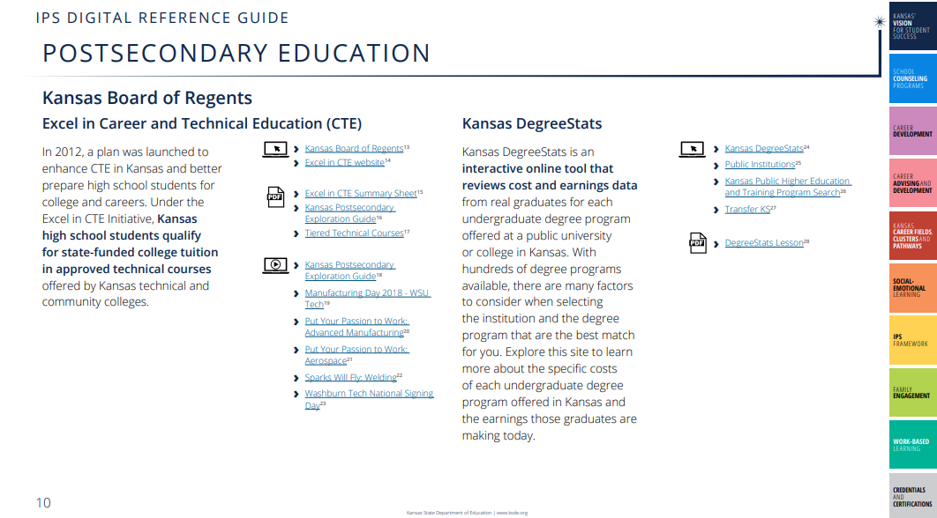

Slide 54
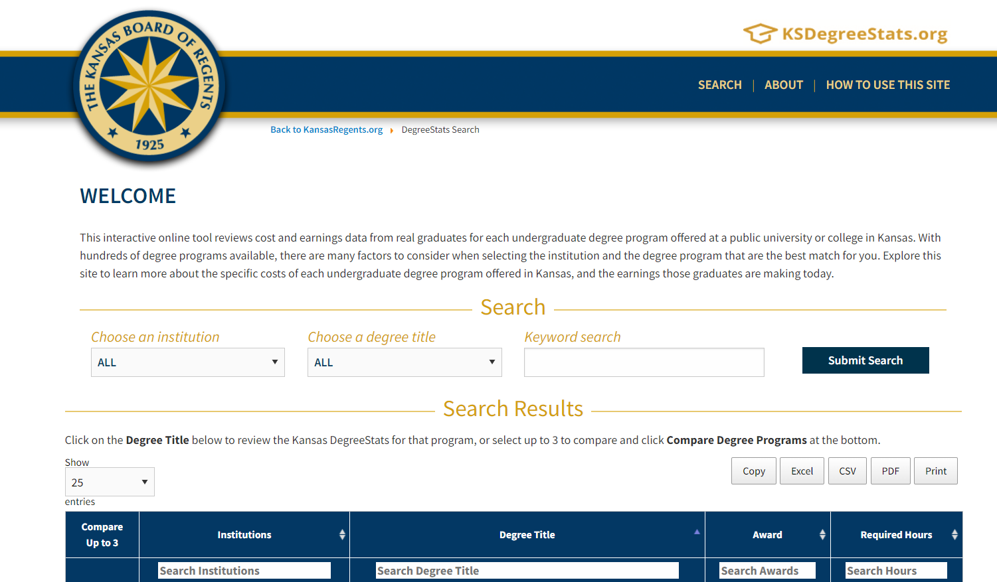

Slide 55
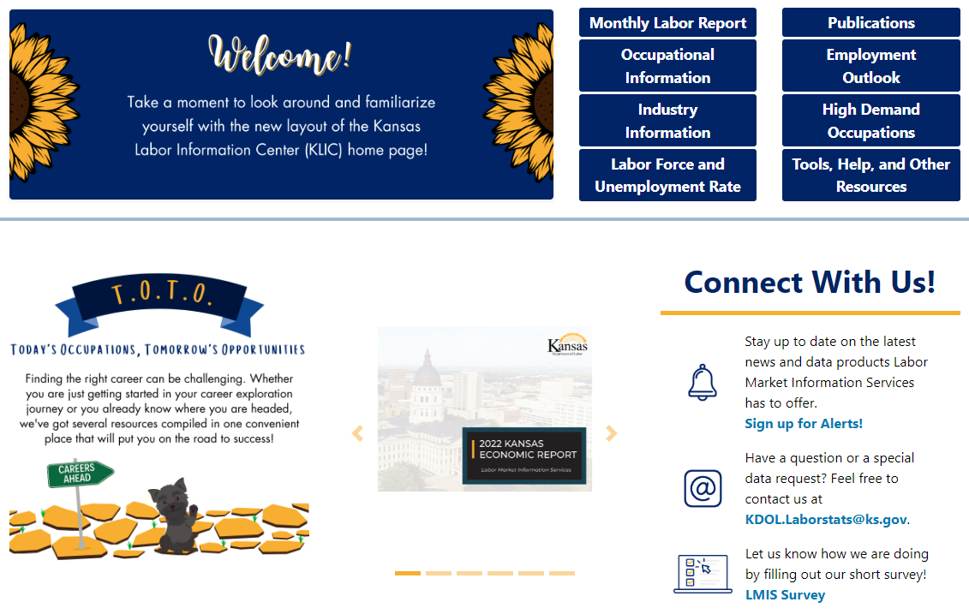
Where Can I Find LMIS Information?
LMIS Homepage: https://klic.dol.ks.gov/

Slide 57
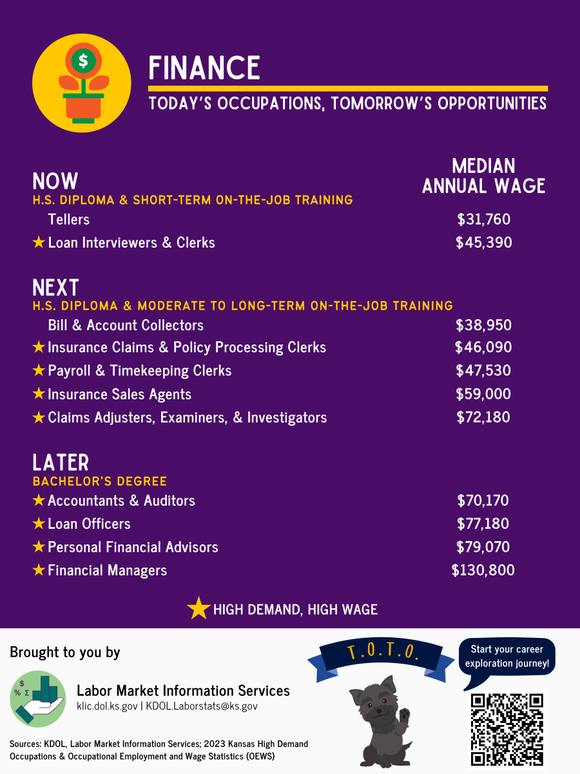
Notes:
LMIS has published a new set of career posters based on the 2023 High Demand list and wages from the 2023 Kansas Wage Survey. We have posters for most of the Kansas career clusters as well as a poster highlighting some high demand STEM occupations. You can view/download each of the posters here: https://klic.dol.ks.gov/vosnet/gsipub/documentView.aspx?enc=UbQEi2djXjv4KxAPLIkAnQ==.
The complete list of high demand occupations including an interactive Tableau dashboard as well as statewide/regional Excel files are available here: https://klic.dol.ks.gov/vosnet/gsipub/documentView.aspx?enc=XR1MJE2Q7Rmn9KjAm0oNxA==.

Slide 58
  Natalie Clark
  Assistant Director
  Career, Standards and Assessment Services
  (785) 296-4351
  ndclark@ksde.org

Slide 59
Licensure Updates
Shane Carter

Slide 60
Updates
Licensed Personnel Report due: March 4th, 2024.
Waivers due: February 1st, 2024.
Mentor Programs Application will open on/around March 19th, 2024.

Slide 61
What is a Registered Teacher
Apprenticeship
Apprentice On-The-Job Learning (OJL):
  Full-time employment in a classroom (assisting a teacher of record).
    Is not the teacher of record during the apprenticeship.
  Learning and mastering teaching competencies.
  Receives wage progression as progress is made in the program.
  Receives National Recognized Apprenticeship Certificate on completion.
Apprentice Related Technical Instruction (RTI):
  Pursuing a bachelor’s degree at an accredited college/university within teacher preparation program.
  Qualifies for Kansas Initial Teaching License.

Slide 62
Roles
Role of KSDE
  Apprenticeship Intermediary (not the W-2 employer).
  Track and report apprentice progress to Kansas Office of Apprenticeship.
  Manage program funding.
  Maintain apprenticeship reporting records and enter it into RAPIDS (USDOL tracking system).
  Issue initial teaching license.
Role of districts
  Apprenticeship Sponsor (W-2 employer).
  On-the-Job Learning Provider (OJL).
  Recruiting/identifying apprentice candidates.
  Hire and train apprentice using competency-based learning.
  Track and report apprenticeship progress to KSDE.
  Maintain apprenticeship progress records.
Role of universities/community colleges
  Related Technical Instruction Provider (RTI).
  Deliver online instruction that is conducive to a full-time work schedule.
  Confer bachelor’s degree within a teacher preparation program.

Slide 63
Outline of Registered Teacher Apprenticeship Requirements in Kansas
Four-year, Competency-Based Apprenticeship
  Flexible duration (based on prior experience and education).
  Assessing Prior Experience.
    Competencies.
    Related Technical Instruction – progress towards a Bachelor’s degree
    Wage Scale.
Series of competences based on Kansas Educator Evaluation Protocol (KEEP), which require individual to be proficient in four different areas:
  Learner and learning.
  Content knowledge.
  Instructional practice.
  Professionalism.
Notes:
Describe business rules for using each – what are the non-negotiables in terms of design, etc.?
Describe logo usage – when to use KSDE, when to use Kansans Can, using dual logos, etc.

Slide 64
Outline of Registered Teacher Apprenticeship Requirements in Kansas
Apprentices earn as they learn.
Apprentice simultaneously enrolled in an accredited community college/university teacher preparation program leading to a bachelor's degree (no new standards required).
Apprentice hired by a district and works under the guidance/supervision of a mentor teacher to learn/demonstrate/hone teaching proficiencies (apprentice will not be the teacher of record).
Apprentice will qualify for teaching license with the following completed:
  Proficient in all competencies.
  Bachelor’s degree/teacher preparation program completed.
  Testing requirements.
Notes:
Describe business rules for using each – what are the non-negotiables in terms of design, etc.?
Describe logo usage – when to use KSDE, when to use Kansans Can, using dual logos, etc.

Slide 65
Funding and Reporting
Funding:
  Up to $5,000 a year for tuition from KSDE (MeadowLARK Grant).
  $2,750 a year for tuition from the Kansas Department of Commerce (K.S.A. 74-50,234).
  KBOR and university/community college scholarships.
  District pays wages. Minimum hourly wage $14 per hour.
  $1,500 for mentor teachers from KSDE (MeadowLARK Grant / KNEA Grant).
  KSDE will cover Praxis Tests (MeadowLARK Grant).
  KSDE will cover initial teaching license fee (MeadowLARK Grant)
  All money will be reimbursed to districts.
Apprenticeship Conference with Kansas Teachers of the Year.

Slide 66
Partnering Community Colleges
Partnering EPPs.
  Allen Community College.
  Barton Community College.
  Butler Community College.
  Cowley Community College.
  Garden City Community College.
  Independence Community College.
  Johnson County Community College.
  Neosho Community College.

Slide 67
Partnering Community Colleges
All Kansas EPPs public and private have 2 + 2 agreements in place.
All Kansas Epps public and private have agreements to transfer Elementary Education Associate degree courses into teacher preparation programs.

Slide 68
Partnering Four-Year Universities
Emporia State University.
  Endorsement Area: Elementary.
Fort Hays State University.
  Endorsement Area: Early Childhood; Elementary; Elementary and Special Education; Secondary World Language (Spanish); History, Government, and Social Studies; Business Education.
Kansas State University.
  Endorsement Area: Elementary.
MidAmerica Nazarene University.
  Endorsement Area: Elementary Unified (Dual endorsement ELED & SPED).
Newman University.
  Endorsement Area: Elementary.

Slide 69
Partnering Four-Year Universities
Ottawa University.
  Endorsement Area: Elementary; Business Education; English/ELA; History/Social Studies; Mathematics.
Southwestern College.
  Endorsement Area: Elementary Education.
Sterling College.
  Endorsement Area: Elementary Education.
University of St. Mary’s.
  Endorsement Area: Elementary Education .

Slide 70
Partnering Four-Year Universities
Washburn University.
  Endorsement Area: Elementary Education.
Western Governors University.
  Endorsement Area: Elementary Education; Special Education; Special Education and Elementary Education; Mathematics (Middle or Secondary); Science Education (Secondary – Multiple Disciples).
Wichita State University.
  Endorsement Area: Early Childhood Unified, Elementary Education.

Slide 71
Partnering EPPs
Maximize current relationships.
Most EPPs have special pricing or scholarships available for enrolling in this program.
Most offer flexibility between online and hybrid courses.

Slide 72
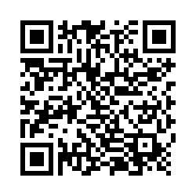
Survey for districts
If your district is interested in participating, please scan the QR code and complete the survey

Slide 73
  Shane Carter
  Director
  Teacher Licensure
  (785) 296-2289
  scarter@ksde.org
Dr. Joel Gillaspie
Coordinator
Teacher Licensure
(785) 296-1862
jgillaspie@ksde.org

Slide 74
LUNCH

Slide 75
Kindergarten Readiness
Amanda Petersen

Slide 76

The vision: Kansas leads the world in the success of each student.
Notes:
In 2015 the Kansas State Board of Education established our Kansans Can vision for education in Kansas: Kansas leads the world in the success of each student. The State Board engaged with thousands of Kansans to develop this vision. Kansans shared that kindergarten readiness is essential to achieving this vision – if we want to lead the world in the success of each student, we have to focus on the critical years of early brain development. The State Board identified Kindergarten Readiness as one of five key outcomes to measure progress toward our state vision.
If you have time for good conversation, you might ask attendees to reflect and discuss – what does kindergarten readiness mean to you/in our school/in our community?

Slide 77
Why do we have a Kindergarten Readiness Snapshot?
The first five years of a child’s life are an incredible opportunity to set a positive direction.
When children, families, schools and communities are ready for kindergarten, students experience greater success in school.
Engaging families to better understand children’s development can improve school readiness.
Kansas accreditation regulations require that each system seeking accreditation shall have in place a method of data collection approved by the state board for collecting kindergarten-entry data.

Slide 78
2024 Kindergarten Readiness Snapshot (Jan. 18 KSDEweekly)
March 1: Schools can begin screening 2024-2025 kindergarten students for the purposes of the Kindergarten Readiness Snapshot
  Review expectations for screening in the springtime
Sept. 20: Final day to screen 2024-2025 kindergarten students
Sept. 27: All ASQ data due in ASQ Online (including paper screenings and pending Family Access screenings)
Year-Round: Schools have access to ASQ Online
Preschool-Aged At-Risk: Students screened within 90 days of enrollment

Slide 79
Number of Kansas children screened
Notes:
2022 - 45,033 ASQ-3 and 43,071 ASQ:SE-2
2023 – 51,567 ASQ-3 and 42,765 ASQ:SE-2

Slide 80
ASQ-3 and ASQ:SE-2 Results, All Ages
January 1 to Dec 31, 2023

Slide 81
Use this template:
agesandstages.com/ks, “Initiative Resources”, “ASQ Results PowerPoint Template”

Slide 82
What we’re envisioning for reports:
Building and district participation rates:
  Count of total kindergarten students enrolled
  Count of kindergarten students exempt (child older than age cutoff or determined screening was inappropriate)
  Number and percentage with complete ASQ-3, complete ASQ:SE-2, and both
Child-level participation list
Building and district aggregate Kindergarten results
Reports would not be available until December/January timeframe

Slide 83
September 2023 Curriculum Leaders Feedback

Slide 84
September 2023 Curriculum Leaders Feedback
I believe collecting the data is important. It has been difficult to get Early Learning teachers to see the value and utilize the results. Checklists that were developed prior to using the ASQ are still preferred by several teachers.
The data coming from the ASQ merely confirms students already flagged. Teachers rely more heavily on other data sources that are already in place. Additionally, by October, teachers already feel they have a good feel for students who are flagged with concerns.

Slide 85
September 2023 Curriculum Leaders Feedback
We have our parents complete this as per KSDE requirements BUT the teachers found this information to not be useful. We went back to using the DIAL in the spring before entry in Kindergarten with all students and our beginning of the year screening data with AIMSweb. Teachers found this data to be more helpful in determining kindergarten readiness.
It is more of a baseline measurement. It is very useful to establish trends, target specific skills, and open conversations with families who self-identify concerns. We use it more effectively through our EC/Pre-K program several times through the year while in Kindergarten unless there is a major concern it is a beginning of the year measure.

Slide 86
September 2023 Curriculum Leaders Feedback
It is good data point. At our school we incorporate both the ASQ and a local screener to look at student data, to make better choices with student placement. Since ASQ is all parent driven we use district screener to compare/contrast results for validity of data.
Principals and teachers want practical ideas of how to use the data to best support child in timely manner.
The ASQ is extremely worthwhile! As an early childhood educator I think the information and conversations this can provide is very beneficial. It helps to give teachers/administrators language to help communicate with parents when there are things that need to be discussed.

Slide 87
Getting ready for Kindergarten in 2024-2025
Review Jan. 18 KSDEweekly – good links and ideas.
Reflect on your overall strategy to support transitions into kindergarten and build relationships with families.
Ensure all kindergarten staff have access to ASQ Online.
Order copies of Kindergarten in Kansas from the Kansas Parent Information Resource Center – the order form is available on the KSDE Early Childhood webpage.

Slide 88
Quick table share – what’s one thing your district does well or has planned to support children, families, and staff to prepare for a great start to the kindergarten year?

Slide 89
Coming in April – Updated Kansas Early Learning Standards
The Kansas State Board of Education approved updates to the Kansas Early Learning Standards at their January 2024 meeting.
  The Kansas Children’s Cabinet and Trust Fund will receive and potentially approve the updates in February.
We are now working on training and implementation supports.
  We do not expect districts to implement the updates in 2024-2025.
Email Natalie McClane (nmcclane@ksde.org) with questions.

Slide 90
Contact Information
  Amanda Petersen
  Director
  Early Childhood
  apetersen@ksde.org
  Stacy Clarke
  Consultant
  Early Childhood
  sclarke@ksde.org

Slide 91
For reference – all years

Slide 92
ASQ-3 and ASQ:SE-2 Results, All Ages
January 1 to December 31, 2019

Slide 93
ASQ-3 and ASQ:SE-2 Results, All Ages
January 1 to December 31, 2020

Slide 94
ASQ-3 and ASQ:SE-2 Results, All Ages
January 1 to December 31, 2021

Slide 95
ASQ-3 and ASQ:SE-2 Results, All Ages
January 1 to Dec 31, 2022

Slide 96
ASQ-3 and ASQ:SE-2 Results, All Ages
January 1 to Dec 31, 2023

Slide 97
Dr. Proctor’s Updates

Slide 98
School Improvement and KESA 2.0
Dr. Ben Proctor
Dr. Jay Scott
Myron Melton

Slide 99
State Board Action – December 2023
Accreditation based on the Four Fundamentals
Accreditation based on the State Board Outcomes
Accreditation based on Student Outcomes
Accreditation based on Compliance
Accreditation accounting for Regulations
Accreditation model that addresses the following:
  Levels of Accreditation
  Timelines Involved
  Responsibilities of KSDE, Systems, and the ARC

Slide 100
KSDE Priority Projects
Develop the School Improvement Model
Develop the KESA 2.0 Protocols
Recruit and Train School Improvement Facilitators
Develop Protocols for the Deep Data Dive
Situate Kindergarten Readiness in the School Improvement Model
Situate IPS in the School Improvement Model
Situate SEL Measured Locally in the School Improvement Model
Partner and Collaborate with Service Centers

Slide 101
Accreditation based on the Four Fundamentals
Develop the School Improvement Model
  Structures and Lead Indicators
Design KESA 2.0 Templates and Protocols
  Deep Data Dive, Reflective Protocol Questions, Action Plan
Recruit and Train Facilitators
  Teams of 3 to lead Data Deep Dive, Reflective Protocol Questions, and Action Planning

Slide 102
Kansas School Improvement Model
Implementing the Fundamentals (Examples)
LEAD INDICATORS
Ex: Plan to Adopt HQIM aligned to State Standards
Ex: Structured Literacy Professional Development
Ex: Elements of Structured Literacy embedded in teacher evaluation
Ex: Elements of Standards-Alignment embedded in teacher evaluation
Ex: PD Plan on implementation of structured literacy (LETRS)
Ex: PD Plan on aligning classroom practice to state standards
Ex: District guidance on professional collaboration on implementation of HQIM and student performance data.
Ex: Adoption of evidence-based practices for at-risk students.
Ex: Site Council engagement focused on the standards-alignment (what students must know and be able to do)
STRUCTURES
Resource Allocation
Educator Evaluation
Professional Learning
Professional Collaboration
Tiered System of Supports
Family & Community Partnerships
FUNDAMENTALS
Structured Literacy
Standards Alignment
Balanced Assessment System
Quality Instruction

Slide 103
Structures (based on the Rand Study)
Influence and shape adult behaviors across a school system.
Reinforce one another and the fundamentals.
Each has leading indicators that reinforce the fundamentals.
Probable structures include:
  Resource Allocation, Educator Evaluation, Professional Learning, Professional Collaboration, Tiered System of Supports, Family & Community Partnerships

Slide 104
Lead Indicators (Covey, 2011)
High-leverage, grounded in evidence – where we must focus our time and energy to maximize impact.
What are our guarantees. What is within our Circle of Control and Circle of Influence?
Discover the right actions (evidence) to reach our goals then act with clarity and consistency.
Predictive in nature and provides more direct and timely indication of the impact of our work.
Influenceable, meaning it is within the team’s control and influence.

Slide 105
Accreditation based on State Board Outcomes
Kindergarten Readiness
  Situating into the reflective question and action planning protocol
Individual Plans of Study
  Situating into the reflective question and action planning protocol
Social and Emotional Learning Measured Locally
  Situating into the reflective question and action planning protocol

Slide 106
Accreditation based on Student Outcomes
Deep Data Dive (Lag Measures)
  Summative State Assessments – Level 1 Performance
  Graduation Rates – All Students and Sub-Groups
  Postsecondary Effectiveness
    Industry Recognized Certification in High School
    Postsecondary Certificate
    Postsecondary Degree
    Enrolled in first and second year following Graduation
Notes:
Jay & Jake
Jay provides an overview that leads into Jake facilitating a discussion around the ways districts look at this data

Slide 107
School Improvement Day
3 – 5 “like” systems collaborating with the discussion led by trained facilitators
Topics for the day:
  Deep Data Dive into Student Outcomes
  Reflective discussion on the 4 Fundamentals and associated Structures & Lead Indicators
  Action planning
Notes:
Jay provides an overview
Jake facilitates discussion around best practices when collaborating on student outcomes across systems (What is most effective and doesn’t become a dog/pony show?)

Slide 108
KESA 2.0 Support Model
Tier 1 (All)
  KESA Check-in (1-on-1 between system and A & D team member)
  School Improvement Day – peer collaboration with “like” systems on student outcomes and Fundamentals, action plan development
Tier 2 (Some)
  Additional support by KSDE
Tier 3 (Few)
  Intensive support by the ARC
Notes:
I like, I wonder

Slide 109
Accreditation and Design Team working through….
Accreditation based on Compliance
Review of Accreditation Regulations
Levels of Accreditation
Timelines for Accreditation
Accreditation Roles and Responsibilities
  KSDE Staff
  School Systems
  Accreditation Review Council

Slide 110
Recruit and Train Facilitators
Skilled in large group facilitated discussion
Systems-thinker and passionate about school improvement & instruction
Flexibility for 2 or 3 days per year
Willingness to learn and teach the KS School Improvement Model

Slide 111
  Ben Proctor
  Deputy Commissioner
  Division of Learning Services
  (785) 296-2304
  bproctor@ksde.org

